Slide 1

MIPS-Based Caesar Cipher System Encryption & Decryption
Group members
Saif
Hassan
Saud
Asad
Salman

Slide 2

What is the Caesar Cipher?
The Caesar Cipher is a simple encryption method where each letter in a message is shifted forward by a fixed number of positions in the alphabet.
Only letters are encrypted
Uppercase stays uppercase
Lowercase stays lowercase
Numbers, spaces, and symbols are not changed

Slide 3

Implementing Caesar Cipher in MIPS Assembly
Input Handling
Character Processing
Output Generation
Check uppercase/lowercase
Encrypts only letters
Wraps around alphabet
Leaves non-letters unchanged
Reads a string from the user
Stores it in memory
Encrypted or decrypted string, non-alphabet characters unchanged.

Slide 4
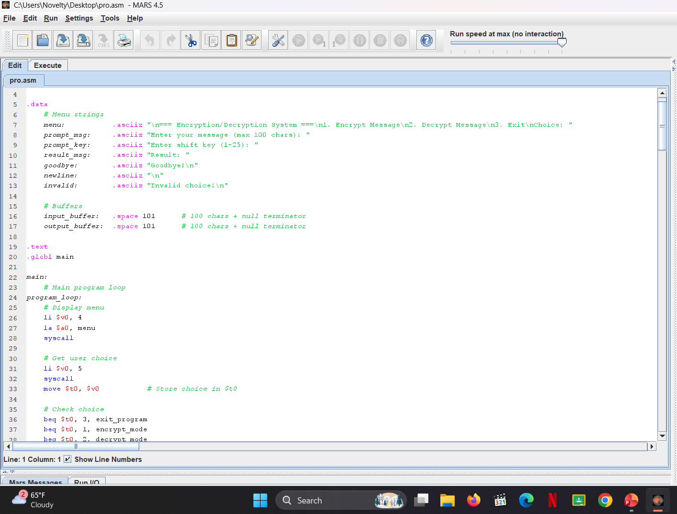
MIPS Code Example: Encrypting a Single Character
Steps:
Load character ASCII into register ($t0)
Check if uppercase (1-25) or lowercase (1-25)
Add key (e.g., 5) to ASCII value
Wrap if beyond 'Z' or 'z'
Store encrypted character back to buffer

Slide 5
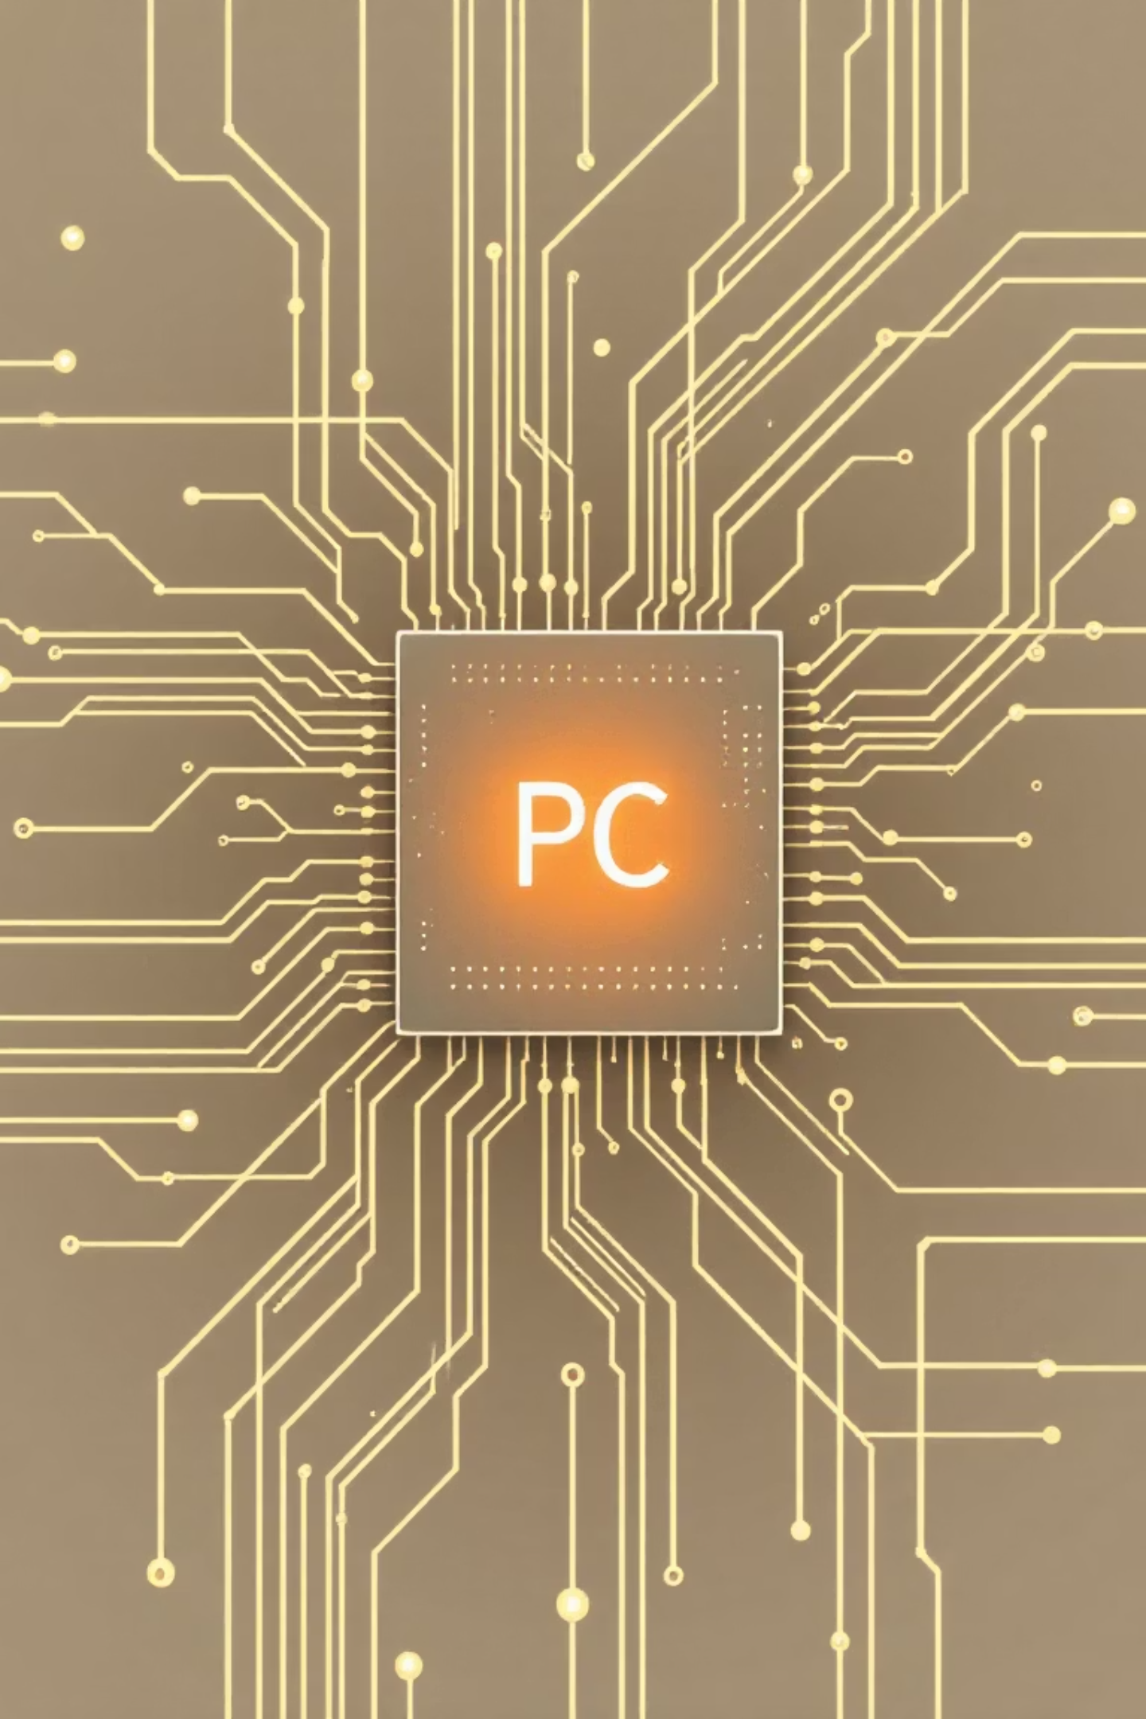

Program Counter (PC) Control
in Caesar Cipher MIPS Program
Sequential Advance
PC moves through instructions in order.
Conditional Branching
bgt, blt for case checks and wrap-around logic.
Jump Instructions
jal for subroutine calls (e.g., case checking).

Slide 6

Pipeline Stages in MIPS
for Caesar Cipher Execution
Instruction Fetch (IF)
Fetch instruction using PC.
Instruction Decode (ID)
Decode instruction, read registers.
Execute (EX)
Perform arithmetic, branch decisions.
Memory Access (MEM)
Load/store characters.
Write Back (WB)
Write results to registers.
Pipeline hazards managed by nop after branches.

Slide 7
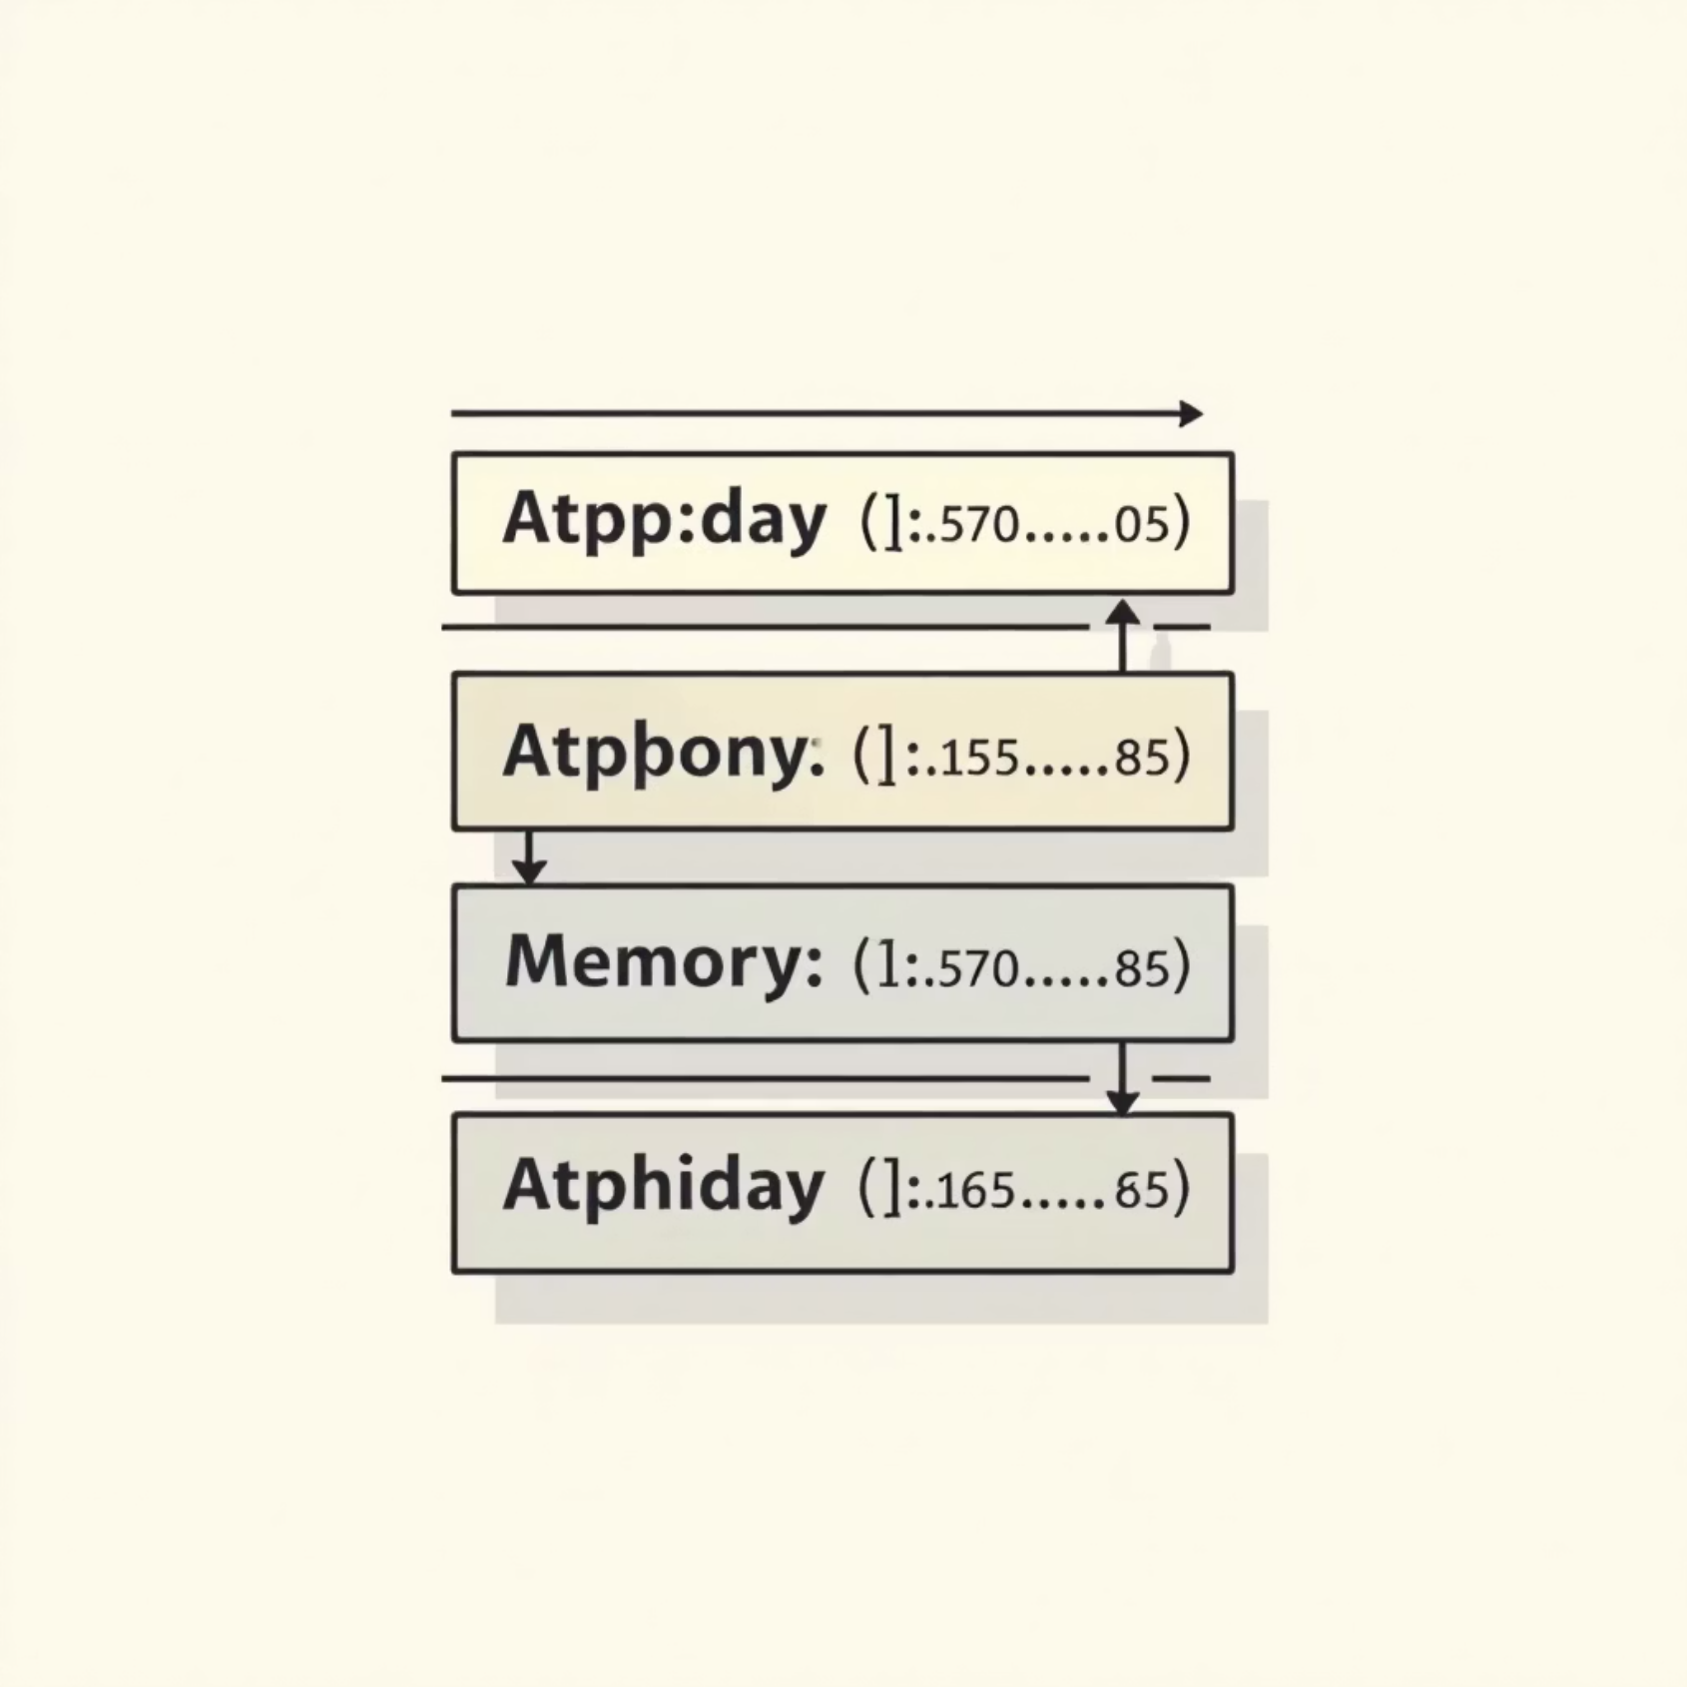
Stack Usage in Caesar Cipher
MIPS Program
Stores return addresses for subroutines
Preserves local variables and saved registers
$sp adjusted on function entry/exit
Enables modular code and recursion-safe execution.

Slide 8

Encryption & Decryption Flow Overview
User Prompt
Encrypt (E) or Decrypt (D) selection.
Input Acquisition
Plaintext/ciphertext string and key.
Character Loop
Process each character individually.
Shift & Wrap
Apply shift (forward/backward), handle wrap-around.
Output
Print transformed character.

Slide 9
Pipeline Stages
Plaintext Input: Original readable data to be secured.
Key Generation: Create a secret or key pair for encryption.
Encryption: Convert plaintext into unreadable ciphertext using the key.
Transmission/Storage: Send or store the ciphertext securely.
Decryption: Convert ciphertext back into original plaintext using the key.
1
2
3
4
5

Slide 10








Conclusion: MIPS Caesar Cipher System Insights
PC & Pipeline
Low-Level Crypto
Practical demonstration of processor control.
Assembly implementation details.
Foundation
Stack Usage
Gateway to complex algorithms.
Understanding memory management.

